Slide 1
READING
A whole school approach

Slide 2
Overview
Phonics
Reading
Spellings

Slide 3
The Teaching of Reading at TWA
Guided Reading
Phonics
Spelling
Guided Fluency and Comp
Indep
comp
Shared reading - Library

Slide 4

Phonics
Daily Phonics Taught through whole class QFT
Keep up sessions taught daily to ensure children working below age related expectations are provided with supported small group focused learning. These target children are identified through half termly assessments so that planning supports gaps in GPC’s.
Little Wandle Programme is introduced from Nursery to Year 2
Children identified as working at Year 1 are taught through the graduated approach to support their learning needs

Slide 5
Guided Reading - Children need to be given regular opportunities to apply the phonics they have learned to reading fully decodable books. The phonic progression in these books must match the progression of Little Wandle Letters and Sounds Revised.
Decoding
Reading with meaning
Comprehension
Aim is to show a good understanding of the text
Graphemes
Prosody
Vocabulary
Tricky words
Stress and intonation
Correct pausing for punctuation
Develop fluency
Answer retrieval questions
Develop inference skills
Definitions of words
Practice automatic reading
‘Tapping in’

Slide 6
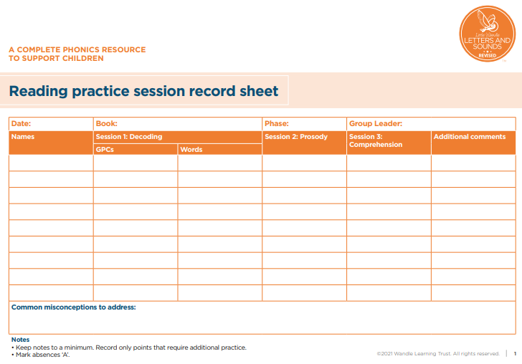

Slide 7
KS2 – Whole class guided reading
Purpose -Developing core transferrable skills
Guided Fluency
When? 1 session a week
Resource – Twinkl, whole class reading books
Guided Comprehension
When? 1 session a week
Independent Comprehension
When? 1 session a week
Purpose – develop fluency, pace and intonation. Explore new words with definitions and practice reading unfamiliar words with accuracy
Resource – Twinkl
Purpose – to transfer skills taught in guided reading session to independent work
This must be marked
Filed in guided reading folders with I for independent
Differentiated to suit individual needs
GR on all work and filed in guided reading folders
Resource – Twinkl
Purpose – Support and scaffold comprehension skills from National Curriculum
Supportive characters to develop Vipers skills evident in classrooms for reference i.e. Iggy Inference
Taught from Year 2-Year 6
Who – Any child not on the Little Wandle programme
Who – Any child not on the Little Wandle programme
Who – Any child not on the Little Wandle programme
GR on all work and filed in guided reading folders

Slide 8
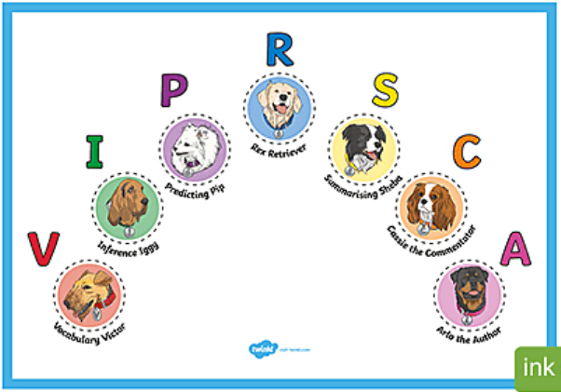
Meet the PAWSOME GANG

Slide 9
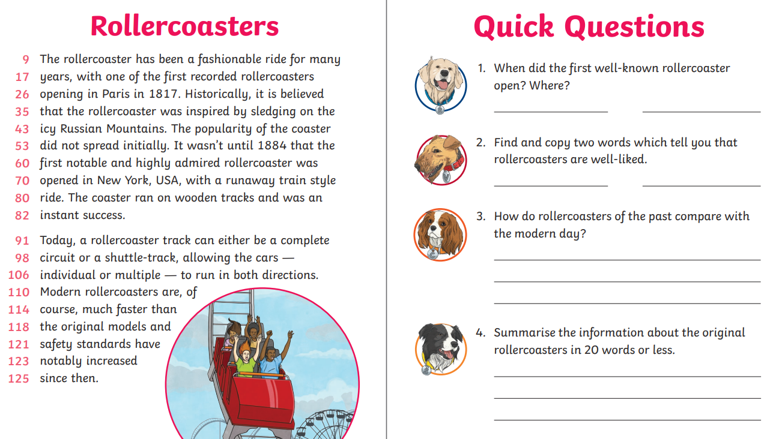

Slide 10
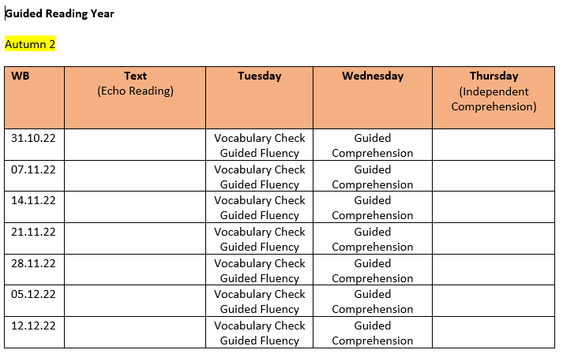
Planning – ensure varied text types and genres

Slide 11
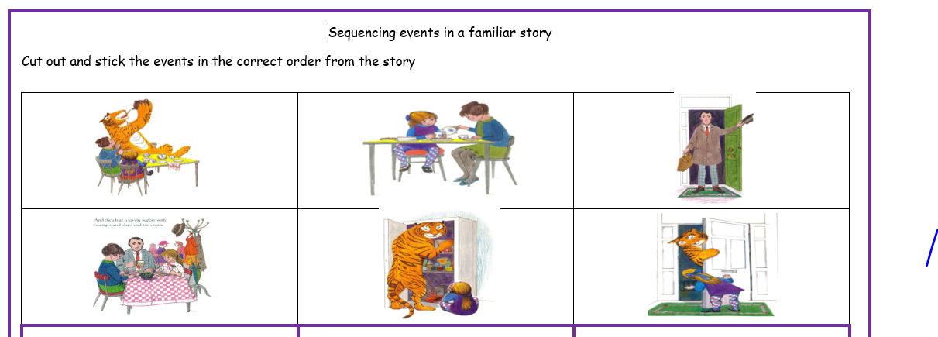
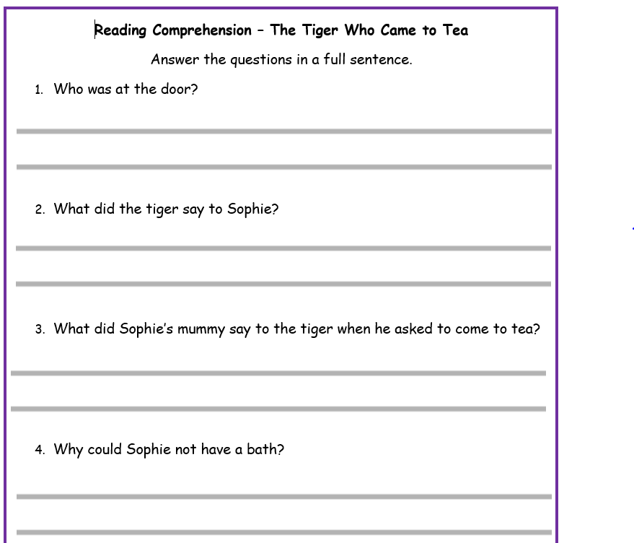
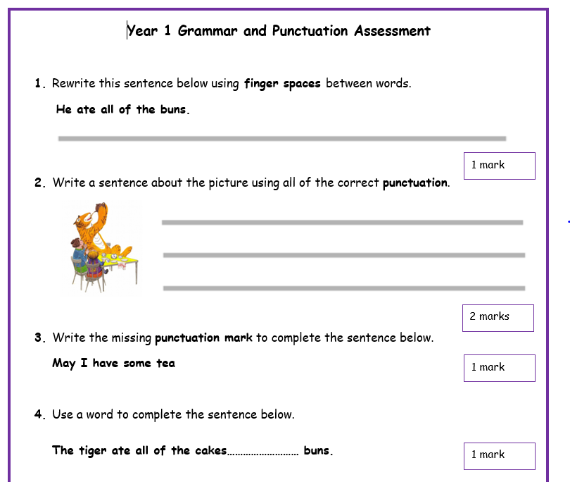
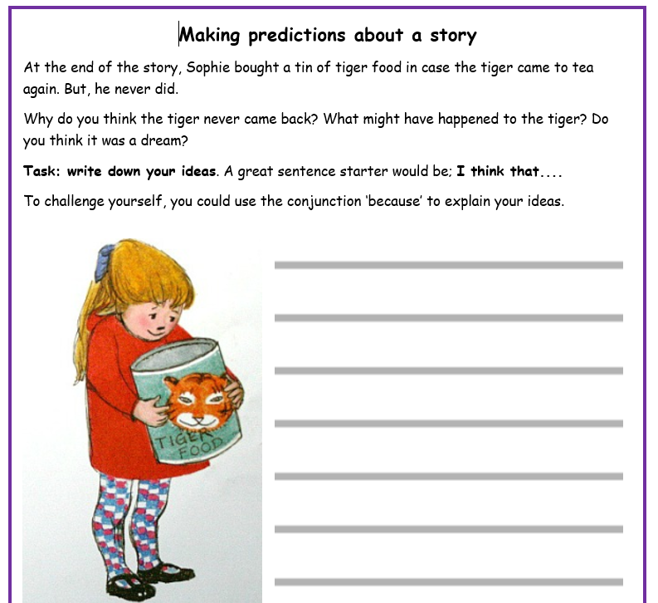
Reading as a Reader – T4W

Slide 12
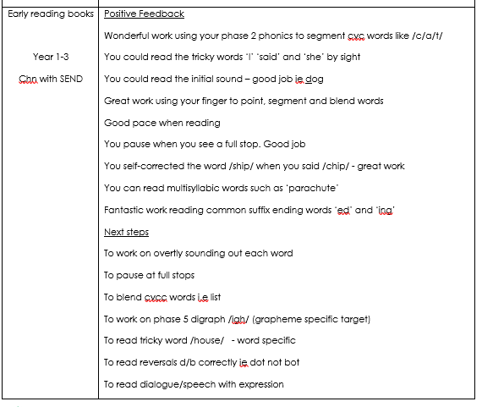
Reading Records
Daily readers identified
Reading records checked daily
Little Wandle children to take home books from their guided reading session at the end of their cycle of guided reading to practice at home
KS2 to take banded books home

Slide 13
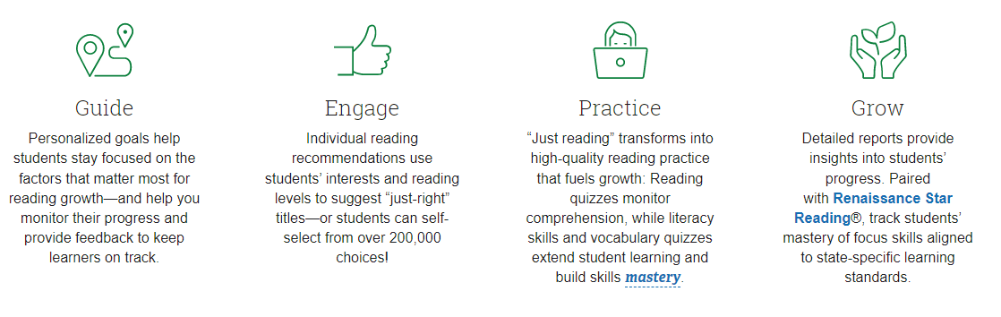
Accelerated Reader

Slide 14
Spellings

Slide 15
Teaching of Spellings
1 taught lesson of spellings
Periodic practice sessions
Spelling words sent home in Reading Books and added to SUMDOG
Spelling test once a week and results recorded in Reading records
KS1
1 taught lesson of spellings
Periodic practice sessions
Spelling words sent home in Reading Books and added to SUMDOG
Dictation in the back of English books
KS2

