Slide 1


Personal Development Overview
Children have opportunities throughout their time at Thomas Whitehead Academy to have rich and varied experiences.
● Regardless of their background, children develop their ‘cultural capital’ and let their light shine.
● Physical and mental well-being are prioritised as much as academic achievements
● Families involved where possible, to support all areas of their child’s personal development
‘Let your light shine’ Matthew 5:16

Slide 2

Growth Mindset
Communication
Resilience
High Aspirations
Self-Aware
Teamwork
Positivity
Happiness
Excellence
Personal Development
Independence
Citizenship
British Values
SMSC
RE
PSHE
RSE
Character Development

Slide 3
Our Vision
‘Let your light shine’ Matthew 5:16
Our vision is to ensure that everything we do is underpinned by our core values of Hope, Perseverance and Respect. Through our Christian values we aim to provide an aspirational and inclusive learning environment, in which every child can let their light shine and flourish.
Our aims as a school are to…
Develop personal strength
Encourage perseverance, resilience and ambition to achieve our goals.
Be happy, safe and feel part of a caring school family.
Work collaboratively in creating a nurturing, caring and inclusive environment for all to learn and flourish, within our school and the wider community.
Value, care for and respect each other and the environment God has created

Slide 4
Wider Opportunities
Development of Character
RSHE – Sex and Relationships Education
SMSC
RSHE- Physical & Mental Well-Being
Personal Development Curriculum
British Values
Citizenship
Protected Characteristics
Inclusion & Equal Opportunities

Slide 5
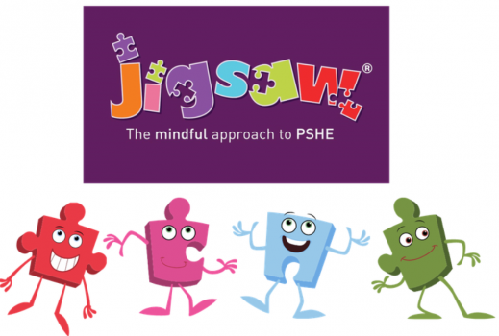
RSHE: Sex and Relationship Education
Children are supported to stay safe
RSE accessible to all
A degree of flexibility to respond to contextual issues that may arise or need to be revisited.
Physical and Mental Well-Being
Speak out Stay Safe
Internet Safety Day
Links to Computing online safety units
JIGSAW PSHE scheme.

Slide 6
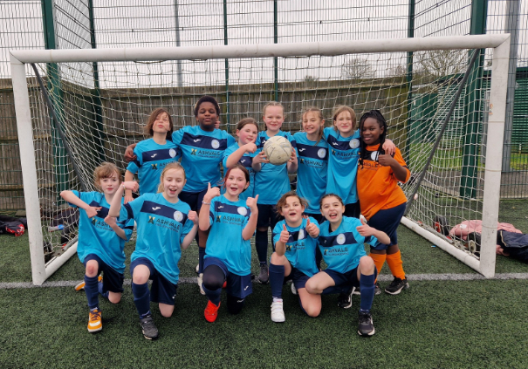
Physical and Mental Well-Being
Growth Mindset
Celebration Assembly
Peer Stars
Anti-Bullying Week
Zones of regulation
Drawing and Talking Therapy
Pupil Surveys
Speak Out Stay Safe
Sports clubs – access to the track

Slide 7
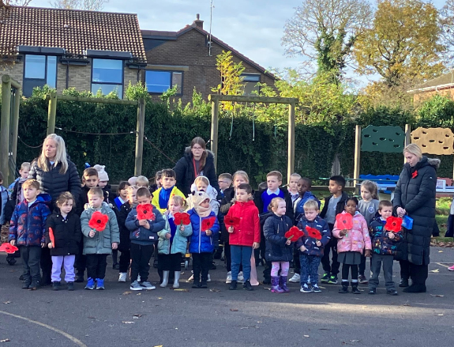
Citizenship
Applications for Roles in school: School Council, House/Vice Captains
Opportunities for democracy: Voting for candidates for House/Vice Captains and School Council Reps
Pupil Questionnaires
Light Leaders Opportunity to write letters to support change
Children engage with the local community – Thorn Springs and Rosalyn House Care homes
Links to English Curriculum – Persuasive units of work
Links to RE curriculum – Citizenship units of work
Visitors to School
Parliament week
Picture News
Collective worship
A variety of charities are supported - local and global
Musical performances in the community
Remembrance in the community
Enrichment
School readers

Slide 8
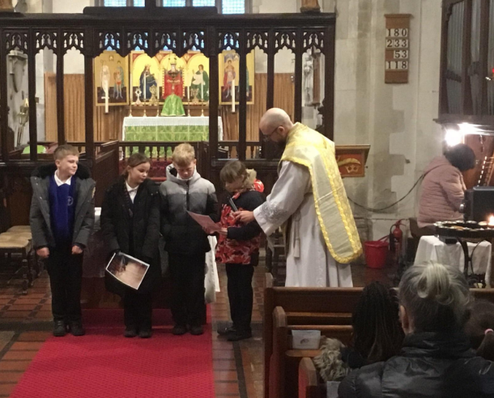
Development of character
Growth Mindset
Zones of regulation
Wider Curriculum and enrichment opportunities
Opportunities to learn a variety of musical instruments
Sporting events for all children
Celebration Assemblies
School Games Partnership
Weekly Collective Worship in Church

Slide 9
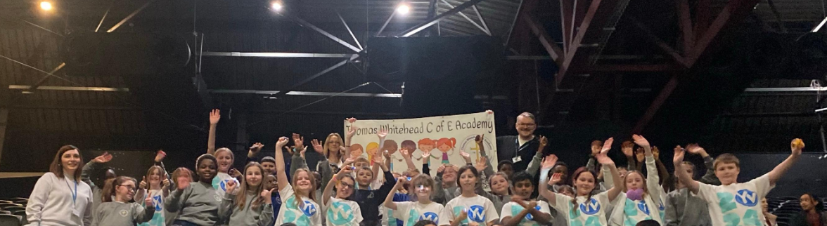
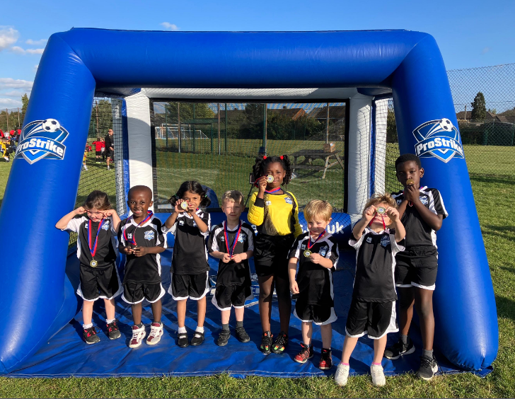
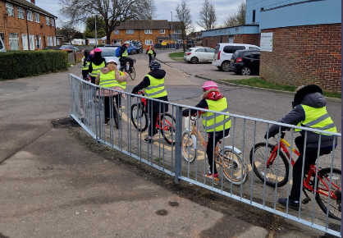
Wider Opportunities
Educational Visits and Residentials
Competitions – Thorn Springs – Christmas, VE DAY. Easter Bonnet competition
Fund-Raising Events: Parent Staff Association, Children in Need, Macmillian Coffee Afternoon
Pupils leading assemblies e.g Remembrance, Christmas Service, Year 6 leading celebration assembly
KS2 Young Voices
Wow Days
Visitors to School
Community Events – Remembrance, Library
Links with Manshead Secondary School
Extra Curriculuar Opportunities
Visits to other schools – Hadrian School links
Bikeability – Years 3, 4, 5 & 6
Trust Primary Choir
Clubs accessible to all children
Sporting Competitions

Slide 10
  SMSC
Spiritual | Moral | Social | Cultural
Collective Worship | JIGSAW Curriculum – including online safety | Transition Programmes | Luton Town Football Club Visits
Windows, Mirrors and Doors | Values | Sports Days – Schools Sports Partnership | Brazilian Football workshop
Visits to places of worship | Collective Worship | Pupil Voice | Art competitions/workshops
Educational Visits | Visitors – e.g Police, Diversity Team, NSPCC, Fire Safety | Community – PTA Disco Coffee Mornings | Celebration of cultures and festivals in school
Residentials | Charity Days | Cross class activities | Yr 6 Enterprise
RE curriculum | School Expectations | Links with other schools | Music – links with schools
Prayer tables & Garden | Light Leaders |  | School Curriculum - class texts

Slide 11
Mental Health and Wellbeing | Clubs on a rota basis | Pupil Leadership
Zones of Regulation curriculum World Mental Health Day PSHE MHST Drawing and Talking Therapy Multi-agency approach – children’s centre VAWG workshop Blue mile track Mindfulness | Sports clubs lunch and afterschool Games Basketball Football Multi-skills Dodgeball Netball Gymnastic Jigsaw club Gardening club Art Lego | School Council meetings Light Leaders House captains – inter house comp Class Reward Voting Outdoor Learning Suggestions Class Greeter Pupil Voice

Slide 12
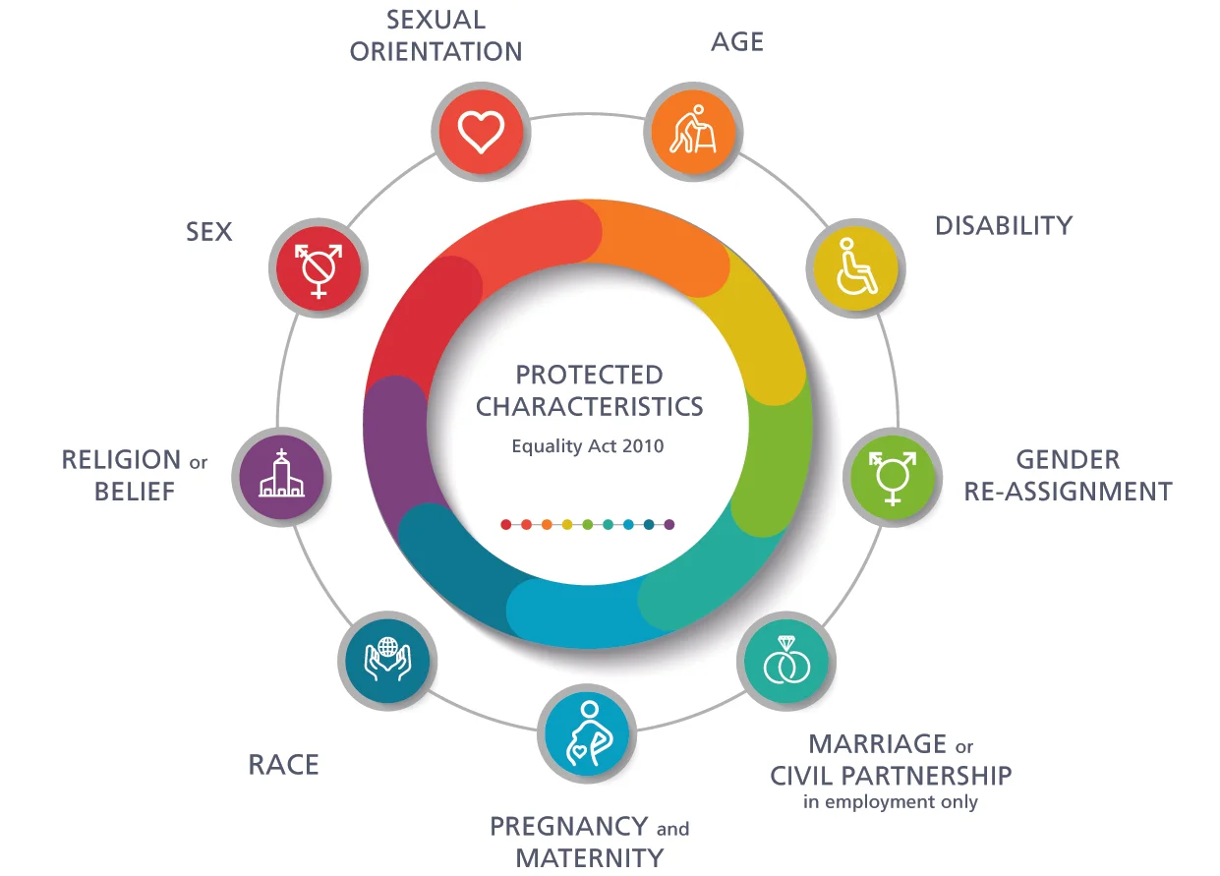
Orientation
PSHE units
Assemblies
Antibullying
Everyone welcome
PSHE of jobs
RSE girls and boys differences
Challenge stereotypes in RSE
Families as part of RSE
Age
Getting Older and growing up
Aiming high – When I am older
Science Curriculum
JIGSAW unit - changes
Disabilities
Celebrating differences in PSHE
Be yourself – pride/identity/uniqueness
Assemblies
PSHE – LGBT within year 6
PSHE it’s my body and Growing up – Just the way you are and relationships
PSHE – Be yourself being unique
Think positive – overcoming challenges
Religion
RE curriculum
Celebrating diversity in school through assemblies
Themed Festival days
Race
Diverse Britain
Diversity and inclusion – Luton Town visits
Anti bullying
Marriage
RSE – Growing up unit families/loving relationships
RE Curriculum unit – the covenant

